Slide 1


RPA Technical Architecture Program

Slide 2
01
Our Understanding
02
Technology Recommendations
03
Implementation Roadmap
CONTENTS
04
Delivery Model
05
Our Capabilities
06
Resource Loading & Costing

Slide 3


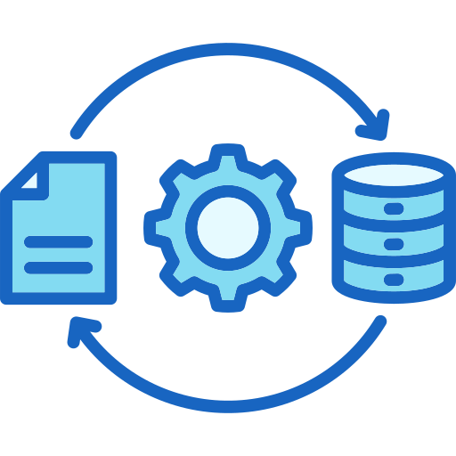
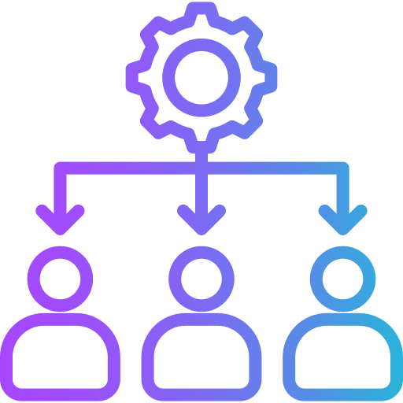

Understanding of the Requirement
The RPA Technical Architecture Program is focused on establishing a robust automation platform tailored to the client's business needs. This includes defining the technical architecture, selecting the appropriate technology stack, and ensuring effective development and operationalization of automation solutions.
1. Assess and Optimize
2. Collaboration for Requirements
Finalization
3. Design & Documentation
4. Development, Testing,
Deployment,
and Monitoring
5. Management of RPA
Infrastructure
*Evaluate the current technical architecture of business processes
*Identify inefficiencies, potential improvements
*Ensure that the architecture aligns with organizational goals
*Ensure that requirements are well-defined
*Collaborate with Business Analysts and Automation Developers
*Create detailed designs for automation solutions
*Document the design thoroughly, including architecture, workflows, and integration points.
*Handle the RPA infrastructure, including UiPath Orchestrator, licenses, servers, and databases
*Maintain and configure the infrastructure
*Oversee all stages of automation projects
*Manage these stages to ensure successful outcomes
Real Time Tracking
Data
Integration
Real Time Tracking

Slide 4
Understanding of the Requirement
6. Code Reviews, Root Cause Analysis (RCA), and Knowledge Transfer
7. Exception Handling
8. Documentation
and
Record Keeping
9. Deliverables and Timeline
*Develop and implement exception handling procedures
*Ensure that automation processes are resilient and can handle errors
*The project is set to be delivered within a 12-month period
*The deliverables will include assessments, design documents, development and testing reports, deployment plans, monitoring strategies, infrastructure records, and documentation of all processes and findings
*Maintain transparent records related to licenses, servers, access credentials, ports, IP addresses, and other critical information
*Create and manage detailed records for all relevant components to facilitate audits, maintenance, and troubleshooting
Real Time Tracking
Data
Integration
Real Time Tracking
*Conduct critical code reviews and provide RCA for exceptions
*Ensure high-quality code, resolve issues, and facilitate knowledge transfer

Slide 5

Technology Recommendations
Based on the requirements outlined in the RPA Technical Architecture Program, here are some UiPath technology recommendations
UiPath Platform
and
Core Components
UiPath Tools
and
Integrations
Security
and
Compliance
Development
&
Best Practices
Monitoring
and
Optimization
Infrastructure
+
+
+
+
+
UiPath Studio
UiPath Orchestrator
UiPath Robots (Attended and Unattended)
UiPath Action Center
UiPath Insights
UiPath AI Center
UiPath Task Mining and Process Mining
Cloud vs On-Premises Deployment
Infrastructure Scaling
Role-Based Access Control (RBAC)
Data Encryption
Secure Credentials Management
Auditing and Compliance Monitoring
Reusability & Modularity
DevOps for RPA
Exception Handling
Testing and Quality Assurance
Bot Performance Monitoring
Continuous Improvement

Slide 6
Implementation Roadmap
The following roadmap outlines the key phases and activities to successfully implement an RPA program using UiPath and related technologies.
01
02
03
04
PHASE
PHASE
PHASE
PHASE
Planning
& Assessment
Design
& Development
Testing
& Deployment
Monitoring & Continuous Improvement
Define RPA Vision & Objectives
Conduct RPA Readiness Assessment
Define Technical Architecture
Process Selection and Prioritization
Solution Design
Infrastructure Setup
Development of Automation Solutions
CI/CD Pipeline Setup
Testing Automation Workflows
Optimize & Fine Tune Automation
Deploy Automation Solutions
Setup Monitoring & Logging
Post-Deployment Monitoring
Continuous Improvement & Enhancements
Knowledge Transfer & Training
Final Handover & Project Closeout

Slide 7
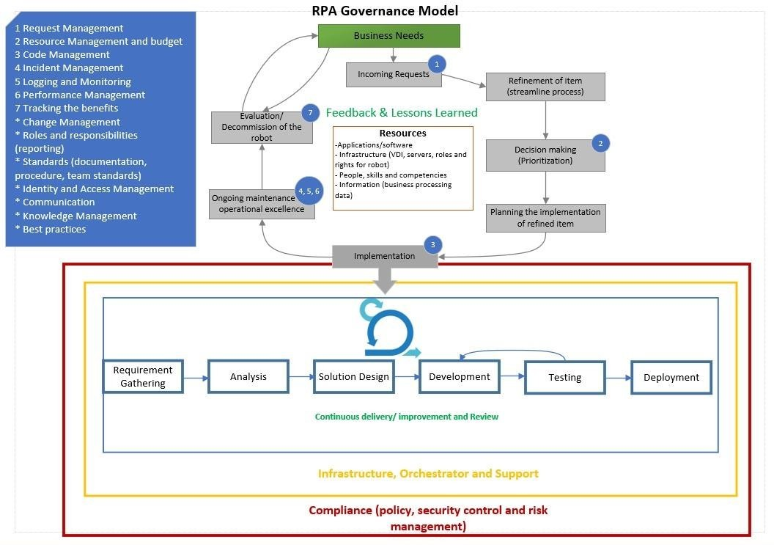
Delivery Model
Netlink will follow the below Governance Model throughout the multiple phases of this project:
Project Governance

Slide 8
Delivery Model
Stage | Role Involved | Key Task | Output
Kick Off | •Solution Architect | •Set up the overall expectations of the project | • Reviewing the SOW
 | • Project Manager | • Early RPA readiness discussions about: | • Setting up communication
 | • Infrastructure Engineer | − Client’s environment and infrastructure | • Completing the customer readiness checklist
 |  | − Test and dev environments | • Initiating the Issue Tracker
 |  | − Test data/test cases
Process Analyze | •Solution Architect | • Analyze the chosen process in its as-is state and start the PDD | • Defining and finalizing the “to-be” process
 | • Project Manager | • Identify the degree of automation | • Completing and approving the PDD
 | • Business Analyst | • Streamline the business flow to the ‘to-be’ process | • Creating and approving the UAT plan
 |  | • Fill the PDD with the as-is and to-be processes
Solution Design | • Business Analyst | • Design a future state flow and maps out modules for automation development | • Completing the SDD document
 | • Solution Architect | • Use Application Tracker to record access required by the developer to build and run automation UAT and Production | • Completing the Application Tracker
 | • Project Manager | • Prepare the Technical Testing plan encompassing UAT scenarios, functional testing, and system integration testing | • Completing the Technical Testing Plan
 | • Automation Developers
Automation Implementation Methodology

Slide 9
Delivery Model
Stage | Role Involved | Key Task | Output
Development & Testing | • Solution Architect | • Create the modules outlined in the design whiteboard using the PDD and SDD | • Building automation
 | • Project Manager | • Review and make necessary changes to the code | • Completing Unit and Integration Testing
 | • Automation Developers | • Test and run the modules individually in controlled settings | • Completing code review
 |  | • Execute the Technical Testing plan after Development and Unit Testing | • Executing Technical Testing plan
 |  | • Create automated tests for functional testing to confirm large functions independently
 |  | • Complete end-to-end test for system integration testing
 |  | • Run all UAT test scenarios
User Acceptance Testing (UAT) | • Business Analyst | • Conduct UAT in coordination with the implementation team | • Executing UAT Test Cases
 | • Solution Architect | • Run all the potential happy path and business exception scenarios | • Signing off client business team test execution
 | • Project Manager | • Ensure all agreed-upon scenarios are tested | • Completing the Run book document
 | • Automation Developers | • Log any deviations and fix that with the help of the Automation Team
 |  | • Create a Runbook document template with the following details:
 |  | − System architecture
 |  | − Production environments
 |  | − Operating instructions for automation
 |  | − Instructions to the operations, IT, and automation implementation team
 |  | • Document the Runbook template for every automation
Automation Implementation Methodology

Slide 10
Delivery Model
Stage | Role Involved | Key Task | Output
Deployment and Hypercare | • Solution Architect | • Migrate the final process packages, libraries, and assets to the production Orchestrator | • Revising the Runbook document
 | • Project Manager | • Identify and address issues quickly using hypercare | • Completing production bug fixes
 | • Automation Developers | • Run and review production cases using hypercare
 |  | • Fix issues promptly and repush to production
 |  | • Initiate knowledge transfer during hypercare
Project Closure | • Business Analyst | • Confirm conformance of all services are made as per the contract | • Checking and signing off contract completion by the client
 | • Solution Architect | • Carry out the handover process for long-term support of the developed automations | • Initiating knowledge transfer and document handover
 | • Project Manager | • Check and close financial loops
 | • Automation Developers
 | • Business Team
Automation Implementation Methodology

Slide 11


Our Capabilities
Licensing
Consulting
Landscape Understanding
Licensing proposals
Reselling
Inventory list down of processes
Opportunity Assessment of RPA
Process Pipeline Prioritization
Performance Assessment
Implement & Support
UiPath COE
Process and Robots Architecture
POC Development and ROI Analysis
Development, Documentation, Testing and Production
Training and Establishing COE
15+ certified UiPath Developers
5+ UiPtah Solution Architects
20+ Process Mining Experts
Implemented 200+ Automations
Netlink is a
Silver Partner
Netlink will follow the below Governance Model throughout the multiple phases of this project:
Licensing
Consulting
Landscape Understanding
Licensing proposals
Reselling
Inventory list down of processes
Opportunity Assessment of RPA
Process Pipeline Prioritization
Performance Assessment
Implement & Support
UiPath COE
Process and Robots Architecture
POC Development and ROI Analysis
Development, Documentation, Testing and Production
Training and Establishing COE
15+ certified UiPath Developers
5+ UiPtah Solution Architects
20+ Process Mining Experts
Implemented 200+ Automations

Slide 12












































Our Capabilities
Integration Expertise
Legacy Systems
Mainframes
OCR
Excel Automation
Email Automation
ERP Applications
SAP
QAD
Salesforce
Web Applications
SharePoint
Custom Apps
Active Directory/LAPS
AUTOMATION LAYER

Slide 13
Our Capabilities
Case Study - 1
Banking
Automation of User Onboarding
Background & Scope
Rule based automation of user management across organizational systems based on source HRMS System.
Active Directory
LAPS
Finacle
E-Learning
Challenges
High human intervention
Involvement of Multiple systems
Mismatch of data in multiple systems
Netlink Solution
We developed RPA Solution to automate the creation of a new user with default password, edit the existing users and disabling users in Active Directory.
The developed RPA solution also creates the users in LAPS, Finacle and E- learning Software.
Results
High ROI due to high volume, disparate systems, multi-step process
Instantaneous onboarding of new employees
Increased data integrity

Slide 14
Our Capabilities
Case Study - 2
Banking
3-Way reconciliation of UPI transactions
Background & Scope
Automate the reconciliation of UPI transactions between multiple systems.
NPCI Portal (Settlements)
Finacle (Core Banking)
Switch (ATM Network)
Challenges
Multiple Manual steps involved
Manual download of UPI data from NPCI portal
Manual extraction of Finacle file
Manual 3-way reconciliation with switch file by vendor.
Netlink Solution
Automation of the reconciliation process
Generate consolidated summary sheet, adjustment files
Generate exception/success report
Automate upload of data to respective systems.
Results
Completes process automatically by fetching the required files from Finacle, Switch, and NPCI portal
Eliminate human error factor
Reduces time drastically

Slide 15
Our Capabilities
Case Study - 3
Banking
Helpdesk EOD and BOD
Process Automation
Background & Scope
Automate the help desk end-of-day and start-of-day process.
Multiple sources of data
Challenges
Multiple sources of data
Teams support and monitor the EOD and BOD processes which needs to be completed on every business day before the branches open
Report extraction from Finacle and mailing to respective stakeholders
Netlink Solution
Automate helpdesk EOD and BOD processes
11 sub-processes to be integrated and automated, including:
Pre & post backup
Business day update
Report extraction
Term deposit provisioning
Ledger folio changes.
Proposed Results
On time completion of EOD and BOD processes
Automated reports mailed to stakeholders
Reduced time for multiple processes

Slide 16
Our Capabilities
Manufacturing
Operational Data Store
Case Study - 4
Background & Scope
To collate data from different system and store it in a single Data Store.
Daily data loading.
Error Handling.
Scalability
Challenges
Data needed to be collected from different systems for any plant floor reporting
Involved manual calculations and prone to errors and lack of visibility.
Full time resources were involved in preparing these reports.
Netlink Solution
Developed multiple RPA processes to extract the required data sets from different systems (SAP, QAD, Tooling, Production Count, etc.)
Flexible data loading frequencies.
Results
High ROI in terms of saved man hours
Increased visibility.

Slide 17
Resource Loading & Costing
To estimate the resources and cost required for the RPA Technical Architecture Program, we'll focus on several key aspects:
• Resource Roles and Responsibilities
• Key Roles and Estimated Effort
• Resource Loading (Full-Time Equivalent - FTE)
• Cost Estimation
Role | Responsibilities
RPA Architect | Define RPA architecture, technology stack, and infrastructure. Collaborate with stakeholders to ensure alignment with goals.
RPA Developer | Develop automation workflows, configure Orchestrator, and implement best practices for automation development.
Business Analyst (BA) | Collaborate with business teams to gather requirements, prioritize processes for automation, and validate outcomes.
QA Engineer | Conduct unit testing, integration testing, and user acceptance testing (UAT) for RPA workflows.
Project Manager (PM) | Manage timelines, resource allocation, risk mitigation, and coordination between stakeholders.
Infrastructure Engineer | Manage RPA infrastructure, including UiPath Orchestrator, licenses, servers, and databases.

Slide 18
Resource Loading & Costing
Resource Loading (Full-Time Equivalent - FTE)
Cost Estimation
Role | FTE Allocation (%) | Effort (Person-Months) | Monthly Rate (AED) | Total Cost (AED)
RPA Architect | 50% | 6 months
Senior RPA Developer (2) | 100% | 12 months
Business Analyst | 40% | 4.8 months
QA Engineer | 50% | 6 months
Project Manager | 20% | 2.4 months
Infrastructure Engineer | 30% | 3.8 months
Role | Total Cost (AED)
RPA Architect
Senior RPA Developer (2)
Business Analyst
QA Engineer
Project Manager
Infrastructure Engineer

Slide 19



Thank You.

